Slide 1
Direct marketing campaign for a Portuguese bank
Edwin Mathew

Slide 2
Agenda
Problem
Assumptions
Goal
Insights
Modeling
Next Steps

Slide 3
Problem
Find (rank) customers most likely to subscribe a term deposits in response to direct marketing campaigns

Slide 4
Assumptions
Phone marketing results are independent of a specific marketer
There are no budget limits on the campaign

Slide 5
Goal
Predict if a customer will subscribe a term deposit
Metric maximized: Area under Precision-Recall curve (PR curve)
Threshold agnostic
Imbalance handling

Slide 6
Background
Historical overall conversion rate: 11.26%
Contacts in data: 41188

Slide 7
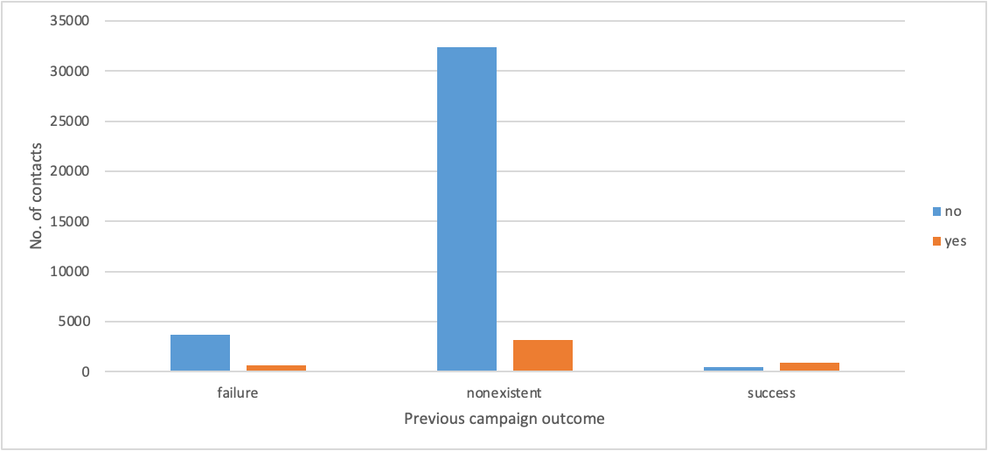
Insights
Successful in previous campaigns

Slide 8
Insights
27% lift in University degree than Professional courses
Likelihood to convert goes down drastically post 7 contacts
20% lift in contacts made on Tue, Wed and Thurs
Took housing/personal loan and no credit default: 13.4% conversion
Opportunity to make term deposits attractive to 30-60 age group

Slide 9
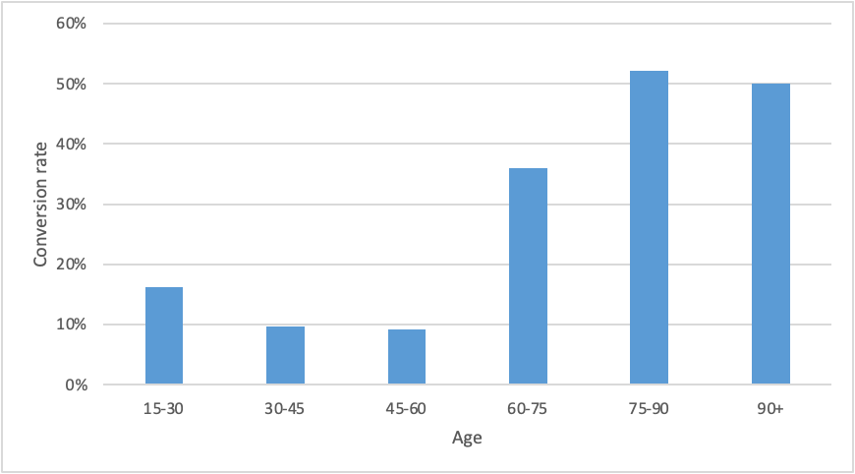
Insights
Ages 15-30 (60% lift), Single (40% lift), Student
Ages 60+ or Retired (127% lift)
Average contact duration is lower for ages 60+ than for 30-60

Slide 10
Modeling
1. Explainable model – to find drivers and detractors
2. Advanced model – best performance on sacrificed explainability

Slide 11
1. Explainable model
L1 logistic regression
Area under PR curve: 45.01%

Slide 12
1. Explainable model
Important features
No. of contacts in previous campaigns
Consumer Price Index (In times of inflation (sharp jump in CPI) and higher interest rates expected by depositors; tendency to reduce inflation)
Consumer Confidence Index (lagging indicator of economic optimism)
Cellular contacts over telephone contacts
Success in previous marketing campaign
Quarterly Employment Variation Rate

Slide 13
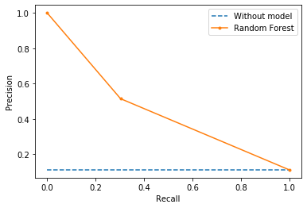
2. Advanced model
Random Forest
Area under PR curve: 44.82%

Slide 14
Next steps
Target customers with
Highest conversion probability estimates from explainable model
Satisfy ideal customer profile
Time the campaigns to be run at economic prosperous times
Account for prejudice-prevention equivalent for Fair housing act and Equal credit opportunity act in Portugal (using Age and Marital status)

Slide 15
References
Data: https://archive.ics.uci.edu/ml/datasets/Bank+Marketing

Slide 16
Thank you!
Thank you for your time!

